Slide 1


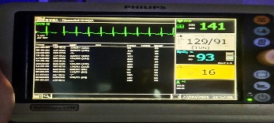
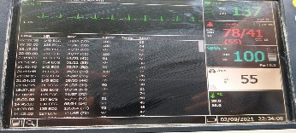
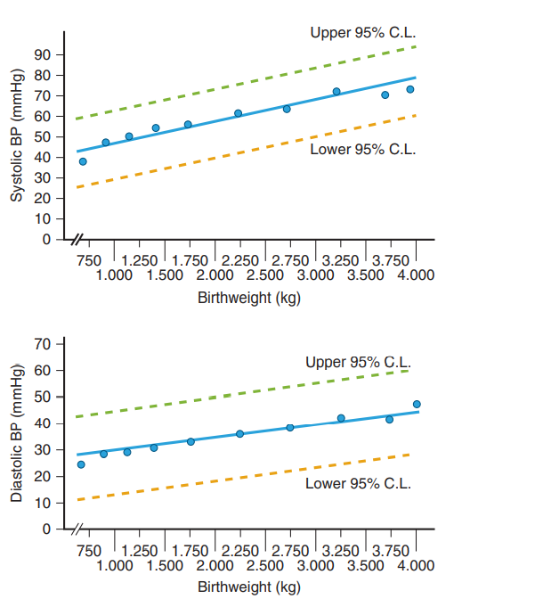
OUR EXPERIENCE OF MANAGEMENT OF NEONATAL HYPERTENSION
Dr Sachin shah, Dr Kashmira, Dr Tushar, Dr Shirish
ABSTRACT
tab Nifedipine 2mg/kg/day qid Started On 20th dol.
Still blood pressure were >99 centile so tab propranolol 3mg/kg/day tds started.
Baby extubated to nasal HFOV on 21st dol.
2D ECHO- LVH 2° to systemic hypertension on 23rd dol
I/v/o persistent high blood pressure (Bp-132/88(103)), Paediatric nephrologist involved & sodium nitroprusside infusion started 23rd dol. 0.1ugm/kg/min (Bp-127/87(100)) up to 1ugm/kg/min on 24th dol. Still bp on higher side so tab clonidine started 9ugm/kg/day tds on 25th dol.
Blood pressure start decreasing (bp-106/63(78)) (bp-100/65(76)) towards normal range so gradually sodium nitroprusside (given for 2 days) tapered and stopped, Lasix stopped on 26th dol.
2D ECHO on 27 dol– hypertrophic cardiomyopathy with good left ventricular function and BP in decreasing in normal range so gradually clonidine(3 days), inj milrinone infusion(total 14 days) and nifedipine(8 days) stopped.
Tab propranolol continued.
2D ECHO on 5/10/21 which s/o decrease in left ventricular hypertrophy.
Signs and symptoms:
Irritability, tachypnea, Oedema
Failure to thrive, tachycardia, sweating,
Feeding difficulty, Seizures, Hepatomegaly
Apnoea, retinal haemorrhage
Cause
Renal Medication/intoxication
Vascular Maternal
Parenchymal Neurologic
Acquired Tumour
Pulmonary, cardiac miscellaneous
Endocrine
“Neonatal hypertension is increasingly recognized in neonatal intensive care units. A variety of factors appear to be important in determining blood pressure in neonates, including gestational age, birth weight, and postmenstrual age. Normative data on neonatal blood pressure values remain limited. The cause of hypertension in an affected neonate should be identified with careful diagnostic evaluation, with the most common causes being renal parenchymal disease, umbilical catheterization-associated thrombosis, and chronic lung disease. Available data suggest that long-term outcomes are usually good, with resolution of hypertension in most infants. We present full term male patient who had hypertension (>99th percentile). His echocardiogram showed poor left ventricular contractility (ejection fraction of 30%) who later developed left ventricular hypertrophy 2° to hypertension. He was started on Nifedipine and propranolol. Later as blood pressure readings were still on higher side, sodium nitroprusside and clonidine were added. Gradually his blood pressure decreased and cardiac function improved. We would like to share our experience of using multiple anti-hypertensive in this child to control hypertension
Investigations:
CBC with platelet count, coagulation profile, s. creatinine, s. electrolytes
Urine analysis, urinary protein/creatinine
S. cortisol, s. aldosterone, thyroxin, and catecholamine
Plasma renin activity
Imaging- renal USG, renal Doppler, nuclear scanning
Advanced imaging [e.g., nuclear scanning, complete tomographic scan or magnetic resonance angiography, traditional intra-arterial angiography, or electron beam CT scan (EBCT)]
EKG and echocardiogram
CT scan of the head
Management:
• Asymptomatic /Mild Hypertension (Systolic 95th to < 99 %) -resolves in time
• Moderate to Severe (Systolic >/= 99th %) – antihypertensive therapy
Address correctible causes of hypertension
• Correct volume overload • wean inotropic infusion • Choose a suitable agent • treat pain • depends on specific clinical situation
Complications:
Hypertensive retinopathy, left ventricular hypertrophy,
Cardiomyopathy encephalopathy
PURPOSE
To sensitize all that we routinely manage patients in NICU with shock and treat hypotension but we should also look for hypertension. A new born having single reading of high blood pressure should be monitor properly otherwise we may miss it and which leads to sequelae.
DEFINITION • Systolic &/or diastolic BP >/= 95%, • Stage 1: BP at 95 to < 99%
• Stage 2: BP >/= 99% + 5 mm Hg
Nwankwo STANDARDIZED PROTOCOL
• Check blood pressure 1.5 hours after feeding/intervention, apply appropriately sized cuff (- 2/3 the length of the limb segment 80-100 % of the limb circumference) Wait 15 minutes or more of stillness. 3 successive readings at 2-minute interval.
IBP most accurate technique • placed in aorta or radial artery.
NIBP measure systolic and mean and calculate diastolic pressure.
Zubrow et al (695 PT infant)
• generated standard curves for mean BP + upper and lower 95% confidence limits
• Regression lines developed based on Birthweight, Gestational age, Post conceptual age.
CASE SUMMERY
A 4th gravida, Singleton mother with normal Antenatal history delivered a full term, 2.6kg male baby via LSCS. Baby required resuscitation & shifted to NICU where baby was intubated & kept on SIMV (pip 27/peep 06/rate50/I time 0.40/fio2 100%).
2D ECHO – PPHN, PDA, PFO, RA & RV dilatation & right to left shunting at PDA and PFO level & so required inotropes, with inj Sildenafil & antibiotics were started.
Because of desaturations and very high ventilator requirements, baby was referred to ANAND NICU for further management on 4th dol.
On admission hr-116/min, bp-51/19 mmhg, spo2-49%, & poor perfusion so baby kept on High freq oscillatory ventilator with map of 16. Parameters increased to (MAP-23/AMP-37/0.33/9/100%) as recruitment strategy. Inotropes and antibiotics started. ABG s/o metabolic acidosis.
Baby successfully extubated to nasal HFOV on 8th dol. Inotropes tapered & stopped on 10th dol & feeding started.
Again respiratory distress increased on 12th dol so kept on Invasive HFOV. ABG s/o mixed acidosis & high lactate.
On 14th dol baby had sudden desaturation & cardiac arrest on HFOV-pt. required CPR, inotropes & antibiotics re-started. Positive septic screen. ABG s/o severe metabolic acidosis.
2D ECHO – severe left ventricular dysfunction with LVEF-30% so Inj milrinone infusion started(0.3ugm/kg/min)
On 17 dol 2D ECHO- LV dysfunction with LVEF-35% & hypervolemia so inj hydrocortisone & inj Lasix infusion started. (Bp-89/70(76)).
On 18th dol blood pressure was 115/88(97) so monitoring done and noticed blood pressure remain higher side > 99th centile 129/88(102), 111/77(88), 113/75(88) so
ZUBROW CURVES
CONCLUSION
Neonatal hypertension is very rare. Due to life-threatening complications associated with target organ damage, appropriate antihypertensive medication has to be chosen and administered at right time to prevent & reduce serious debilitating conditions. Sodium nitroprusside can be considered in a management of neonatal hypertension. Due to serious side effects of cyanide poisoning, monitoring thiocyanate levels with metabolic acidosis and lactate is very crucial. Safety issue still concerned with sodium nitroprusside.
For any query kindly contact author: shirishkapadiya@gmail.com

