Slide 1
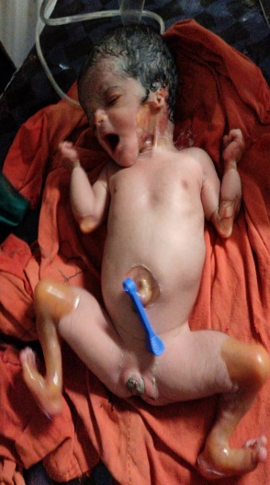
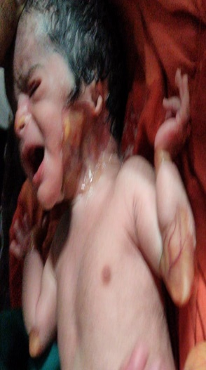
SGA
CARMI SYNDROME -A RARE ENTITY IN NEWBORN
First author Dr. Swati Dubey Co-Author : - Dr.Sambhaji Chate (HOD Dept.of pediatrics SRTR ambajogai )
Introduction :- Coappearance of junctional epidermolysis bullosa (JEB) with congenital gastrointestinal atresia, most frequently pyloric atresia (PA), and aplasia cutis congenita (ACC) represents a disease pattern that is often described as Carmi syndrome. It follows an autosomal recessive pattern of inheritance with prevalence of < 1 case /10 lac
Skin manifestations include severe blistering, atrophic scarring, and nail dystrophy. Congenital absence of skin (aplasia cutis congenita) is common, and ear anomalies are also relatively common. The manifestations of pyloric atresia include intractable vomiting, abdomen distension,. Other extracutaneous manifestations include involvement of the respiratory, gastrointestinal and genitourinary tracts malformation (polypoid bladder wall lesions, hemorrhagic cystitis, urethral strictures) are relatively frequent and characteristic. Growth delay and anemia,, are common. Polyhydramnios, secondary to pyloric atresia, is usually present.
Antenatal diagnosis can be made based on raised serum AFP level [>20x of normal value ]with polyhydramnios
Genetic counselling can be offered to at risk couples
Other investigation like electron microscopy ,immunofluorescence can be. used to confirm skin lesions in newborn
Case report:- A 37 week female 2.5 kg delivered via LSCS ivo polyhydroaminos with meconium stained liquor with breech presentation born of non consanguineous marriage to primi mother was admitted in NICU ivo meconium aspiration , skin lesion and syndromic features (malformed ears with triangular facies )
Course : Baby was started on antibiotics and Ivf through a peripheral line.kept on o2 by CPAP in a humidified incubator ,baby developed bouts of vomiting and abdominal distension with ANC scan s/o distended foetal stomach with solid component within. Skin lesion were rinsed with 0.9% NaCl followed by disinfection with Povidone-iodine ,silver sulfadiazine was applied .and wound was covered with a sterile gauze .inspite of aggressive supportive management baby succumbed to infection and died on day 6 because of septicemia .
Discussion;- The condition is caused by biallelic mutations in either of the genes encoding the two subunits of alpha6-beta4 integrin, ITGA6 (2q31.1) and ITGB4 (17q11-qter).
CONCLUSION:
Management of Carmi syndrome needs a multidisciplinary approach.
Reporting of this rare entity must increase so newer modalities can be established for better survival .

