Slide 1
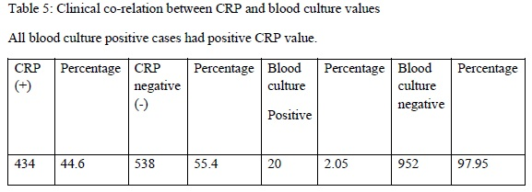
Clinical profile of neonates admitted in a tertiary care Neonatal Intensive Care Unit
Dr. Nishigandha Sonawane, Dr. Sambhaji Chate, Dr. Ramesh Lomte
Swami Ramanand Teerth Rural Medical College & Hospital Ambajogai Maharashtra
Title of the study:
Clinical profile of neonates admitted in a tertiary care Neonatal Intensive Care Unit
Abstract:
After birth the smooth transition to the extra-uterine environment is essential to help newborns survive the most critical period of life with good outcomes. We conducted a retrospective review of all neonates admitted in NICU during 12 months study period in NICU.Clinical determinants of neonatal sepsis in mother along with demographic clinical profile with laboratory co-relation was the main purpose of the study conducted. A single centre retrospective study for the correlation of C reactive protein with blood culture in evaluation and treatment of neonatal sepsis in a tertiary care neonatal intensive care unit.
Introduction:
Neonatal sepsis is a systemic infection occurring in infants at 0 to 28 days of life and is an important cause of morbidity and mortality of newborns.
The primary threatening signs and symptoms of neonatal sepsis are mostly nonspecific and can easily be mixed up with the non-infective causes. Nonspecific signs/symptoms make it very challenging to formulate a timely clinical diagnosis.
C-reactive protein (CRP) is the most extensively acute phase reactant studied so far and despite the ongoing rise of new infection markers it still remains the preferred index in many neonatal intensive care units.
Materials and Methods:
The study was conducted in Neonatal Intensive Care Unit of a tertiary care centre. All neonates born within August 2020 to August 2021 were enrolled in the study. The presenting clinical features of admitted neonates with suspected sepsis and values of CRP and blood culture report were recorded and results formulated. This study indicated that raised CRP could be used a marker for sepsis due to its high sensitivity, specificity, positive predictive value and negative predictive value.
Results:
A list of all newborns who were admitted to the NICU during the study period was obtained from the hospital electronic database. Data was extracted from the electronic medical records after a comprehensive review of the admission notes, daily progress notes, consultation notes, discharge summaries, problem lists, medication sheets and laboratory investigations. Demographic characteristics, risk factors in mother, indications for NICU admission, morbidities and outcomes were reported as documented by the admission doctor. Data collection was conducted by well trained pediatric resident and interns using pre-tested variables and documented in an excel spreadsheet. Total NICU Admissions in our NICU over a period of 12 months were 486.
Risk factors present in mother during antenatal period were classified based upon clinical maternal determinants for admission of newborns in neonatal intensive care unit.
Conclusion: Neonatal septicemia is an important cause of neonatal morbidity and mortality. Neonatal sepsis is an important cause of hospital admission in the neonatal intensive care unit
of our hospital. This study highlights the sensitivity and negative predictive value but lower specificity and positive predictive value of CRP and blood culture. The present study depicts a significant co-relation between culture positivity and CRP values. Blood culture is the gold standard for diagnosing septicemia. Several laboratory and clinical correlates are available to identify neonatal septicemia amongst NICU admitted neonates, hence this study classifies various determinants of neonatal diagnosis and associated maternal risk factors responsible for neonatal sepsis

