Slide 1
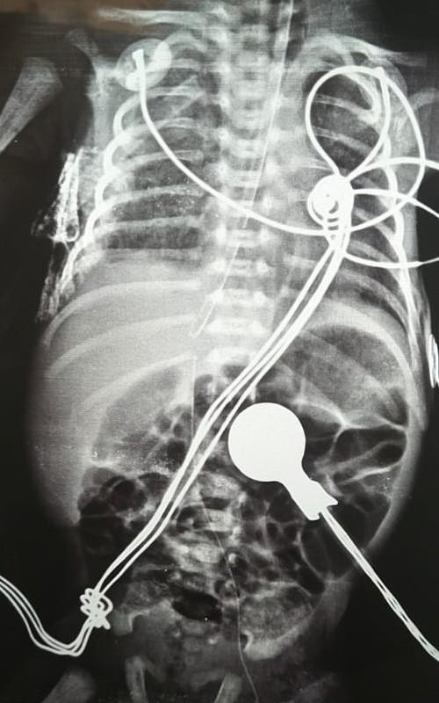
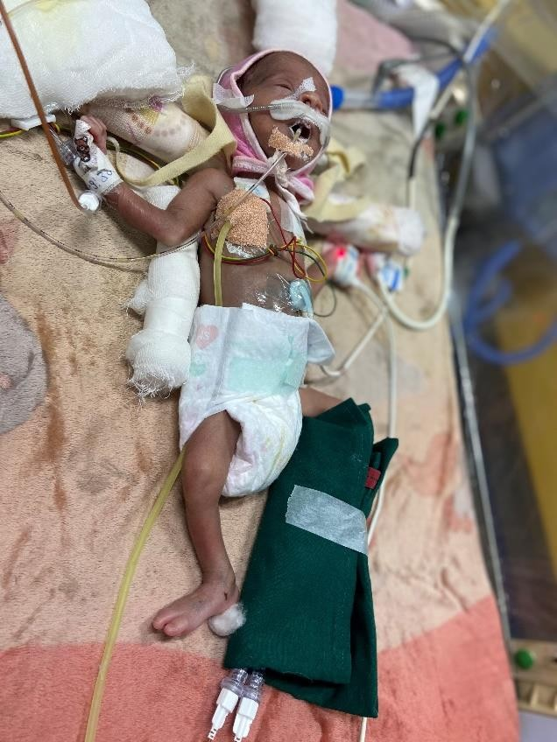
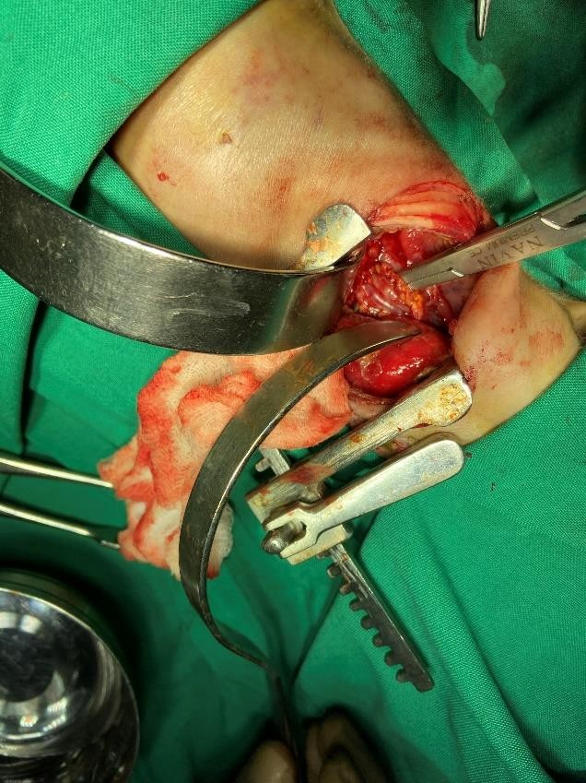
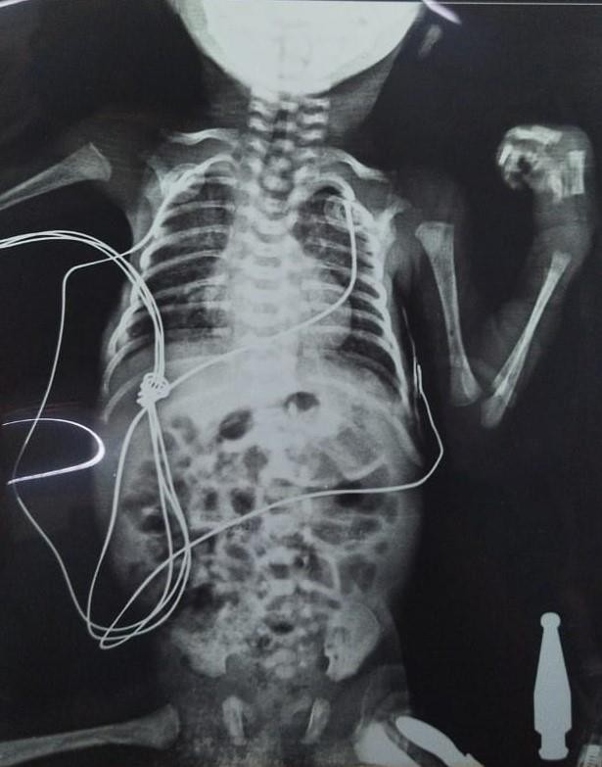
NEONATAL EMPYEMA THORACIS DUE TO CANDIDA SEPSIS : AN UNUSUAL RESPIRATORY CATASROPHE IN AN ELBW NEONATE
Dr. Pooja D. Sonani, Dr. Sachin A. shah
ABSTRACT
Empyema thoracis, is a rare cause of respiratory distress in neonates. Empyema thoracis is not a well-known entity in the neonates. Only a few cases of neonatal empyema thoracis are described in medical literature. It is fulminant with rapid progression with a high mortality. We describe here one case of neonatal empyema in a newborn aged 2 days caused by candida species. He was managed successfully with respiratory support, antibiotic & antifungal therapy and surgical intervention. Baby was discharged home on full feeds.
Key words: Empyema thoracis, fungal sepsis, Neonate, Thoracotomy
THE CASE
An extreme preterm 29weeks,male,weighing 1kgs at birth was born to a Primi gravida mother. Baby had low Apgar score 4/10, required intubation in the delivery room and shifted to our NICU for further management. On admission Baby was put on conventional ventilator and treatment started with Iv fluid,1st line antibiotics, inj caffeine & inj aminoven. X-ray chest was s/o respiratory distress syndrome. As baby was not maintaining saturation on conventional ventilator with high settings and 100% Fio2,baby was shifted on High frequency oscillatory ventilator.1 dose of surfactant was given.2D ECHO was done which was s/o improving persistent pulmonary hypertension. On DOL-2 baby developed significant oedema and septic screen was also positive, so antibiotics were upgraded. On HFOV baby developed right sided pneumothorax so thoracentesis was done & Chest drain was inserted , in ICD tube thick pus was observed, so Ultra solography of thorax was done to which was s/o right lung consolidation with right pleural effusion. Blood culture grew Corynebacterium so antibiotics were planned accordingly. PUS swab culture was s/o candida species, so inj amphotericin-b was added. As there was continuous PUS in the ICD tube was observed and baby was requiring high ventilatory support, repeat PUS swab culture was sent which grew staphylococcus aureus & candida albicans hence inj voriconazole was added. In spite of our ventilatory strategies and continuous drainage of pus through icd tube with on-going antifungals and antibiotic therapy pus collection was persistent. Meanwhile we noticed few x-rays were s/o pneumomediastinum so retrospectively we thought possibility of any structural abnormalities and to ruled out Paediatric surgeon's opinion was taken. As per his advice surgical exploration was planned on DOL-15, and right sided lobectomy was done, during surgery very fragile and ruptured lower 2/3rd segment of oesophagus was observed, so Perforation was repaired and feeding gastrostomy was done. Baby tolerated procedure well and post operatively baby was managed on conventional ventilator, feeding was started through gastrostomy tube and graded up gradually, baby was gradually weaned off to hhfnc and off respiratory support by DOL-44, Post operatively the course in NICU was uneventful, and baby was discharged on full feeds and regularly following up.
CONCLUSION
Though neonatal empyema thoracis is a rare newborn infection,
it should be considered in a newborn with chest infection that fails to respond with conventional treatment, and both conservative and surgical approach could be adapted. We found only few cases of neonatal empyema described in the medical literature. It is a rare entity in the neonatal period. Experience in the management of neonatal empyema is lacking and no standard protocol is currently available. The key to success is immediate identification of effusion, prompt initiation of empiric broad-spectrum antibiotics, and early effective chest tube drainage and surgical intervention.
INTRODUCTION
Empyema thoracis is defined as pyogenic infection of pleural cavity with accumulation of pus in the pleural space which can be diffuse or flocculated. The most common causative organisms in pleural empyema in neonates are S.aureus, E.coli, Klebsiella, Hemolytic GroupB streptococcus, hemolytic Group A Streptococcus and Serratia sp.We are presenting a case of neonatal empyema which has occurred in our hospital’s newborn unit.
REFERENCES
Winnie GB, Lossef SV,Purulent Pleurisy or Empyema. In Kliegman.Stanton,St. Geme,Schor,Behrman,
Nelson Textbook of Paediatrics; 19th Edion,2011, Philadelphia Saunders Elsevier,Pg 1507
Khan EA, Wafelman LS, Garcia- Prats JA, Tabe LH. Serra a marcescens pneumonia, empyema and pneumatocele in a preterm neonate. Pediatric Infectious
Dis J 1997;16:1003-5.
Nathavitharana KA, Watkinson MA. Neonatal
pleural empyema caused by group A Streptococcus
4. Brook I. Microbiology of empyema in children and adolescents. Pediatrics 1990;85(5):722–726. 6.
Fig 1: X-ray s/o ICD tube in situ
Fig 2: ICD tube draining pus
Fig 3 : Intraoperative photo of ruptured oesophagus
Fig: 4 Post operative Chest X-ray
showing Resolution of the right sided opacity

