Slide 1
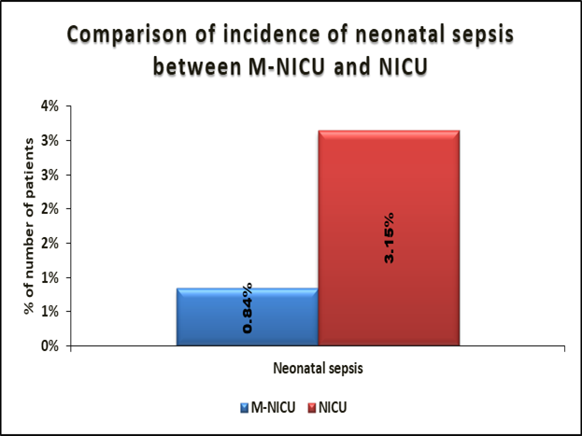
DOES PRESENCE OF MOTHER WITH SICK NEONATE IN NEONATAL INTENSIVE CARE UNIT 24X7 INCREASES INCIDENCE OF NEONATAL SEPSIS?
SUHAIL CHHABRA, HARISH CHELLANI DEPARTMENT OF PAEDIATRICS , V.M.M.C & SAFDARJUNG HSOPITAL
INTRODUCTION
RESULTS
According to DeNIS study the incidence of neonatal sepsis is 2.2% of all live births and that of culture positive sepsis 0.95%. Reported mortality from all causes of sepsis is 25% while that from culture positive sepsis is 47% ^{[1]}
KMC was associated with a statistically significant reduction in the risk of mortality (risk ratio [RR] 0.60, 95% confidence interval [CI] 0.39 to 0.92; eight trials, 1736 infants), nosocomial infection/sepsis (RR 0.35, 95% CI 0.22 to 0.54; five trials, 1239 infants), and hypothermia (RR 0.28, 95% CI 0.16 to 0.49; nine trials, 989 infants; moderate‐quality evidence) as per Cochrane database of systemic reviews ^{[2]}.
However in most of the setups the KMC rates are poor as mother visits intermittently into the NICU to provide KMC. Also it becomes difficult for the postnatal female to visit NICU for KMC very frequently compromising with the KMC duration and hence its benefits. To bridge this gap a new concept of Mother-Neonatal ICU (M-NICU) came into context. In MNICU the mother is not a only visitor, but she has her bed inside the NICU by the side of baby’s warmer/incubator ^{[3]}
Hence this new concept of Mother-Neonatal intensive care unit may be contributing to reduction in incidence rate & severity of neonatal sepsis. But there was a concern with the concept of M-NICU and zero separation that whether presence of mother and the surrogate 24×7 in the NICU could increases the neonatal infection. To clarify this concern we have conducted this study where we compared the incidence of neonatal sepsis among low birth weight babies (1-1.8kg) in Neonatal Intensive Care Unit (NICU) and Mother in Neonatal Intensive Care Units (M-NICU) to see whether presence of mother 24×7 in NICU alongside the baby actually increases the infection or reduces it.
In present study there was no significant difference of the Period of gestation, Mode of delivery, Birth weight, Gender distribution & Area of parental residence among the two study groups i.e. NICU and M-NICU neonates.
Incidence of neonatal sepsis was significantly low in M-NICU (0.84%) as compared to NICU (3.15%) with significant P value of 0.002.
Relative risk for the incidence of neonatal sepsis calculated to be 1.411 suggesting risk of sepsis was 1.411 times higher in NICU as compared to M-NICU.
Morbidity indicators like time to start feeds and duration of the hospital stay was significantly lower in M-NICU babies as compared to NICU babies with significant p value of <0.0001.
The mortality was higher in NICU (4.72%) as compared to M-NICU (1.9%) . Also the relative risk calculated to be 2.5 with 95%CI (0.496 to 12.602) suggesting mortality in NICU is 2.5 times higher as compared to M-NICU ( as seen in table 03) but the p value is 0.455 which is insignificant may be due to small sample size .
Bacterial flora causing sepsis and meningitis in M-NICU was sensitive to all first line antibiotics like ampicillin, gentamycin along with second and third line antibiotics whereas bacterial flora of NICU was resistant to first line antibiotics like ampicillin and gentamycin and few to second line antibiotic like amikacin but shows sensitivity to Netilamycin, Piperacillin tazobactum, and colistin. But as per the analysis antibiotic sensitivity of bacterial flora in both NICU and M-NICU was comparable with insignificant P value may be due to small sample size.
Time to start feed(in days) | MNICU(n=104) | NICU(n=101) | P value
<=3 | 95 (91.4%) | 52 (51.5%) | <.0001§
>3 | 9 (865%) | 49 (48.5%)
Mean ± SD | 2.19 ± 1.32 | 3.42 ± 1.89 | <.0001*
Median(25th-75th percentile) | 2(1-3) | 3(2-4)
Range | 1-9 | 1-12
MATERIALS AND METHOD
Duration of hospital stay(in days) | M-NICU(n=106) | NICU(n=106) | P value
<=10 | 75 (70.8%) | 39 (36.8%) | <.0001§
>10 | 31 (29.3%) | 67 (63.2%)
Mean ± SD | 10.57 ± 5.08 | 13.24 ± 4.99 | 0.0002*
Median(25th-75th percentile) | 9(7-12) | 12(10-15)
Range | 3-27 | 7-32
RESEARCH QUESTION
Whether presence of mother with neonate in neonatal intensive care unit changes the incidence and severity of neonatal sepsis among low birth weight babies?
OBJECTIVE
To compare the incidence of neonatal sepsis among low birth weight babies (1-1.8kg) in Neonatal Intensive Care Unit (NICU) and Mother in Neonatal Intensive Care Units (M-NICU).
STUDY DESIGN : Prospective cohort study
STUDY VENUE : Department of Paediatrics, VMMC & Safdarjung Hospital New Delhi
STUDY POPULATION : Inborn neonates with birth weight 1-1.8 Kg irrespective of gestation and mode of delivery.
SAMPLE SIZE CALCULATED : 212
OUTLINE OF STUDY :
Babies from the labour room requiring level 2 NICU care were shifted to NICU or M-NICU on the basis of randomisation and were followed up for clinical sign of sepsis. In those where clinical sign of sepsis was present investigation like sepsis screen, Blood culture and sensitivity, Lumber puncture were taken. Based on results of these investigations the incidence and severity of neonatal sepsis in NICU and M-NICU were compared.
DISCUSSION
Outcome | M-NICU(n=106) | NICU(n=106) | Relative Risk | P value
Discharged | 104 (98.1%) | 101 (95.3%) |  | 0.445‡
Mortality | 2 (1.9%) | 5 (4.7%) | 2.5
Total | 106 (100%) | 00%)
The worldwide concern that Presence of mother or surrogate in NICU may increase neonatal sepsis is not true as proved by the results of this study which suggested significant reduction in incidence of neonatal sepsis in M-NICU as compared to NICU. Also the Comorbidity in the babies admitted in M-NICU were low characterised by early start to feeding and lesser duration of hospital stay. There are several possible mechanisms by which KMC might confer benefits to the baby. Since the mother and the baby are in close contact from birth, the baby is more likely to be colonized by mother’s protective micro biome that plays protective role for the neonate. Also mother would be able to initiate breast feeding as early as possible which has its known beneficial effect to reduce mortality and morbidity in neonates. Another reason behind reduction in sepsis due to presence of the mother is that there would less handling of the baby by other person which reduces the risk of the infection. Since the mother has to take care of just her child there will constant and frequent monitoring of baby by the mother herself.
REFERENCES
1.Investigators of the Delhi Neonatal Infection Study (DeNIS) collaboration. Characterization and antimicrobial resistance of sepsis pathogens in neonates born in tertiary care centres in Delhi, India: a cohort study. Lancet Glob Health 2016;4: 752–760.
2.Conde-Agudelo A, Diaz –Rossello JL. Kangaroo mother care to reduce morbidity and mortality in low birth weight infants. Cochrane Database Syst Rev 2016;8: CD002771.
3.Chellani H , Mittal P , Arya S. Mother – Neonatal intensive care unit (M- NICU):A Novel concept in newborn care. Ind Pediatr. 2018 Dec 15; 55(12):1035-1036.
CONTACT INFORMATION
NAME- Dr Suhail Chhabra
PG RESIDENT DOCTOR
DEPARTMENT OF PAEDIATRICS
VMMC & SAFDARJUNG HOSPITAL
Email- naveena.maa@gmail.com

