Slide 1
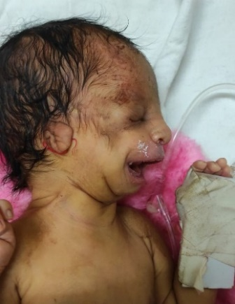
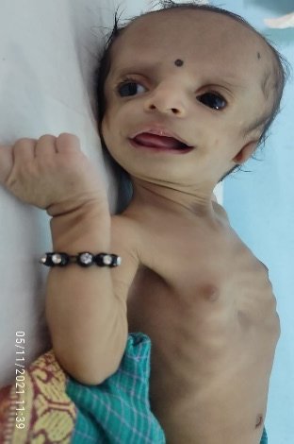
SGA
TREACHER COLLINS SYNDROME -A RARE GENETIC DISORDER
First author Dr.Sagar Mavale Co-Author : - Dr.Sambhaji Chate (HOD Dept.of pediatrics SRTR ambajogai )
Introduction :- incidence 1 in 50000 live birth ,Autosomal dominant affect both sexes equally A/K/A Mandibulofacial dysostosis
TCS cases.. Only 40% of the mutations are inherited, and the remaining 60% are de novo Most of the features of TCS are bilateral including hypoplasia of the facial bones, external ear anomalies and conductive hearing loss, eye problems like loss of vision, strabismus, anisometropia, coloboma , ocular hypertelorism, cleft palate, and airway problems which are often a result of mandibular hypoplasia and brachycephaly . Nasal deformities (large, beak-like nose with obstructed or small nasal passages), , high arched palate , choanal atresia, macrostomia, Dental anomalies are seen in 60% of TCS patients which can lead to problems with food intake and the ability to close the mouth
Pt with this syndrome have normal IQ and grow up to be functional adults with normal life spans. The OMENS classification is used to classify the disorder
Case report:- A 39 week female delivered via LSCS ivo oligohydroaminos with meconium stained liquor born of non consanguineous marriage to primi mother was admitted in NICU ivo meconium aspiration with syndromic features
(Antimongoloid slanting palpebral fissure with partial absence of eyelid cilia , midface and zygomatic hypoplasia
Microtia with B/L absence of external auditory canal ,retrognathia with high arch palate )
Course : Baby was started on antibiotics and Ivf through a peripheral line. IG Feed started on day 2,gradually wsf was established pt was discharged on D12, on discharge baby was advised BERA for Hearing
Reconstructive surgery , flexible bronchoscopy for Airway problems with regular followup
Discussion;- TCS is caused by mutations in the TCOF1, POLR1C or POLR1D genes that affect facial development before birth. TCOF1 is located on chromosome 5 and encodes the treacle protein , and mutations in this gene account for 81% to 93% of all TCS cases. POLR1C and POLR1D gene mutations are responsible for 2% of the
CONCLUSION:
Each case of Treacher collin syndrome is unique and need multidisciplinary apparoch
The best therapeutic outcomes are therefore achieved with early intervention

