Slide 1
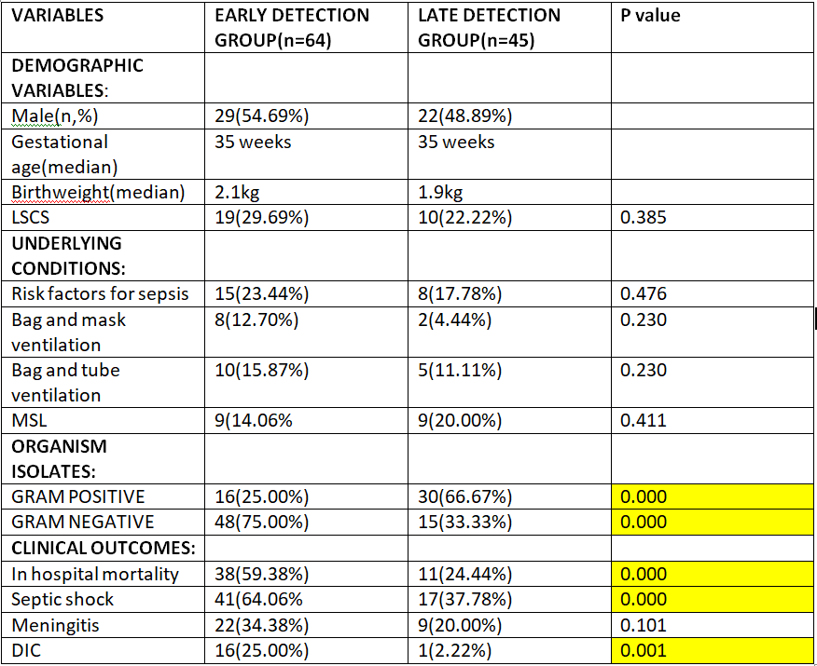
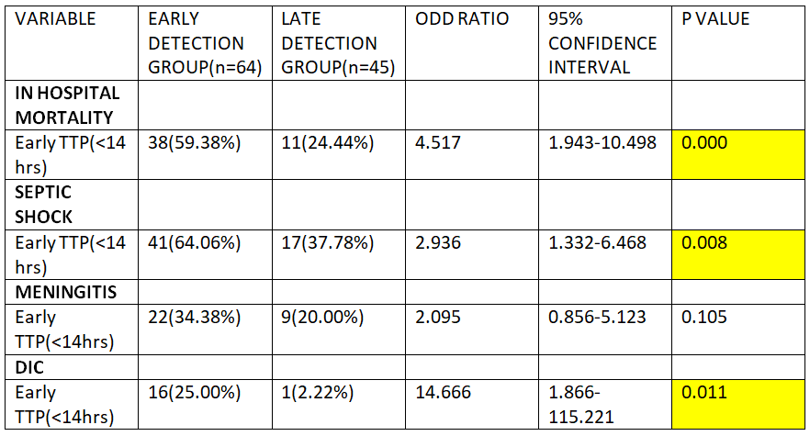
PREDICTION OF CLINICAL OUTCOMES OF NEONATAL SEPSIS BY TIME TO POSITIVITY OF BLOOD CULTURE
SAURAV SHARMA, SUGANDHA ARYA Department of Pediatrics, V.M.M.C. and Safdarjung Hospital
INTRODUCTION
RESULTS
A multisystem disease with a positive blood culture within the first month of life is characterized as neonatal sepsis.
Infant sepsis has been related to increased medical costs, a longer hospital stay, and possibly poor long-term neuro-developmental outcomes [1].
Despite prompt initiation of efficient antibiotic therapy, approximately one-fourth of neonates survive with serious neurological sequelae as a result of CNS involvement, septic shock, or hypoxemia leading to severe parenchymal lung disease.
Blood culture is the gold standard for diagnosis of septicaemia and should be performed in all cases of suspected sepsis prior to starting antibiotics.
Time to positivity (TTP) is defined as the time period between blood incubation and the positive signal, whereby all individuals are included only once. If multiple cultures come positive, the shortest TTP is recorded [2].
The correlation between TTP and clinical outcomes in neonatal sepsis patients, on the other hand, is unknown. The goal of this study is to see if there's a correlation between TTP and clinical manifestations and outcomes in newborn sepsis.
In this present study of 109 patients with neonatal sepsis, demographic, clinical and laboratory parameters were assessed to find the Correlation between Time to positivity of blood culture and outcomes in neonatal sepsis.
In the present study, the median time to positivity of blood culture of the 109 neonates was 16.5hrs (range 1.5hrs to 96hrs).
For gram negative culture isolates, the median TTP was 12.5hrs (3 hrs to 70hrs) while for gram positive culture isolates, the median TTP was 19hrs (1.5hrs to 96hrs).
Receiver operating characteristic curves of TTP were plotted according to the primary outcome (in-hospital mortality). We found 14hrs to be the optimal cut-off point (70% sensitivity, 73.47% specificity, area under curve= 0.731). Therefore we selected 14 hrs as the standard cut-off. Based on this, patients were divided into two groups: Early detection group (TTP≤ 14hrs) and Late detection group (TTP>14hrs).
On comparison between these two TTP groups, demographic characteristics, risk factors for sepsis, presence of meconium stained liquor, need for resuscitation, occurrence of meningitis- all were similar between the two groups.
However, the other parameters showed important differences. In the early TTP group, 75% cultures were Gram negative but only 33.3% cultures were gram negative in the late TTP group(p value=0.000). In- hospital mortality was 59.38% in early TTP group but 24.4% in late TTP group(p value=0.000). Shock occurred in 64% cases in early TTP group and 37.7% cases in the late TTP group(p value=0.000). DIC occurred in 25% cases in early TTP group and 2.2% in late TTP group(p value=0.001). These results indicated critical clinical differences between the early and late groups.
In the univariate analysis, Early TTP has shown increased risk of mortality with significant p value(0.000) and odd ratio 4.517. Early TTP has also shown increased risk of septic shock and DIC with significant p values(0.008 and 0.011) and odd ratio(2.936 and 14.666) respectively. For meningitis p value is 0.105 and is not significant.
MATERIALS AND METHODS
RESEARCH QUESTION
What is the correlation between time to positivity of blood culture and clinical outcomes in neonatal sepsis cases?
OBJECTIVE
Primary Objective: To determine the correlation between time to positivity of blood culture and mortality in neonatal sepsis.
Secondary Objective: To determine the correlation between time to positivity of blood culture and septic shock, disseminated intravascular coagulation(DIC) and meningitis in neonatal sepsis.
Study design: Prospective Cohort Study
Study place: Newborn unit, Department of Pediatrics in collaboration with Department of Microbiology, VMMC and Safdarjung Hospital
Study population: Inborn neonates with culture positive sepsis
Sample size calculated: 90
OUTLINE OF STUDY
Sepsis was suspected in all admitted neonates, who had maternal and perinatal risk factors for sepsis or in presence of clinical features attributed to sepsis. All infants suspected of having sepsis were examined. Before starting any antibiotic medication, a sepsis screen and blood culture were sent under stringent aseptic conditions.
The patient was investigated and managed according to unit protocol. After receiving informed consent from one of the parents, all successive inborn babies with culture proved sepsis were recruited in the study.
Data recorded for each of the cases included maternal details including risk factors for sepsis, birth details, clinical features, investigations including sepsis screen, csf studies and Time to positivity of blood culture and outcomes- death or discharge.
[1] Sankar MJ, Agarwal R, Deorari AK. Sepsis in the newborn. Indian J Pediatr. 2008;75:261-6.
[2] Yuanyuan Li, Qinyuan Li, Guangli Zhang, Huan Ma, Yi Wu, Qian Yi, et al. Time to positivity of blood culture is a risk factor for clinical outcomes in Staphylococcus aureus bacteremia children: a retrospective study. BMC Infectious Diseases 2019; 19(437).
DISCUSSION
In the present study the prognostic role of TTP of blood culture in neonatal sepsis was studied. We documented that early TTP group patients had 5-fold higher in-hospital mortality, 3-fold higher incidence of septic shock and 15-fold higher incidence of DIC than those with late TTP group patients. Early TTP was an independent risk factor of in-hospital mortality, septic shock and DIC incidence, which indicated that early TTP is associated with worse clinical outcomes in neonatal sepsis cases. The concept of early TTP of blood cultures is directly related with a higher bacterial load in blood. This is in line with study done by Yuanyuan et al [2], early TTP was found to be an independent risk factor for in-hospital mortality and septic shock in children with Staphylococcus aureus bacteremia. However, our study has provided data for neonatal sepsis.
REFERENCES

